Slide 1



Grandmaster
Forecaster?
SJK006_FINAL_PROJECT
JANUARY_2024
Pablo Muñoz Alcaide / Raquel Lázaro Belenguer

Slide 2

Table of Contents
1
2
Data Architecture
Motivation
3
4
Implemented Data Value Chain
Analytical goals
5
Model Implementation
6
Results
7
Use of LLMS
8
Conclusions

Slide 3


Motivation
Analyze the best strategies
Predict the winner

Slide 4

2. Data
Architecture

Slide 5

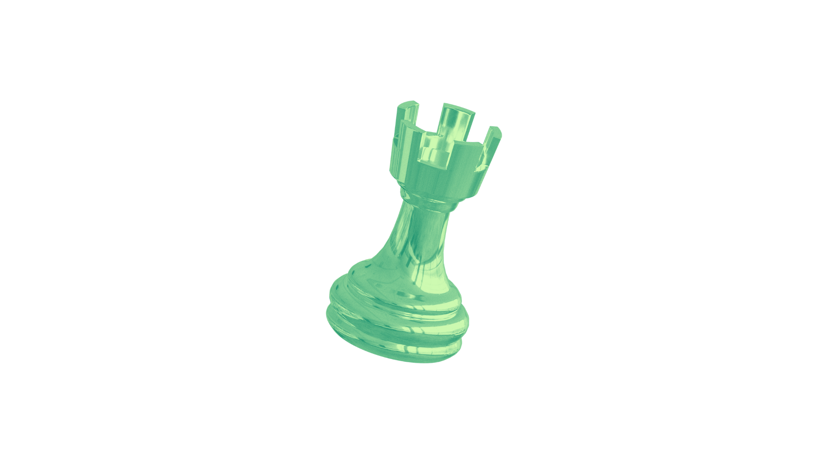
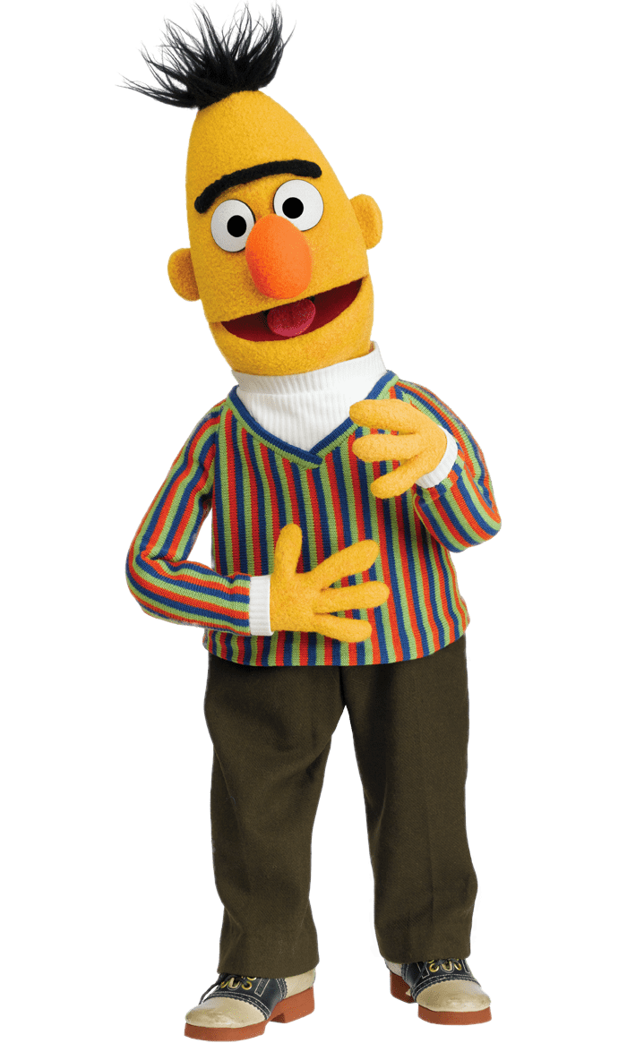

QUERY
Batch Layer
Serving Layer
Raw Data
Processing
Historical
analysis
QUERY
Stream Data
Processing
Pre-Trained Model
Winner Prediction
Speed Layer

Slide 6
3. Analytical Goals
1
Describe
the data
Predict
game
outcomes
2
3
Understand and analyze the model

Slide 7
4. Implemented Value Chain
CHESS DATA
TRANSFORM
Preprocess for analysis
Embedding and hot-encoding
ANALYZE
Inspect agrupations
Visualize
Descriptive analysis
CHESS DATA’
Win predictions
Predictive
analysis
LEARN
xgboost model
PREDICT
xgboost model
CHESS DATA’’
Refined
win predictions
Refined
predictive
analysis
ANALYZE
Shap analysis
LEARN
xgboost model 2
PREDICT
xgboost model 2
Notes:
Fer-lo bonic. Però serien dues: (Indicant els processos) (Dades)->Preprocess -> Embeddings -> Xgboost -> Win Prediction
Xgboost (altra fletxa q ix el xgboost anterior)-> Qué aporta més a les win_predictions(shap)

Slide 8

5. Model
implementation

Slide 9
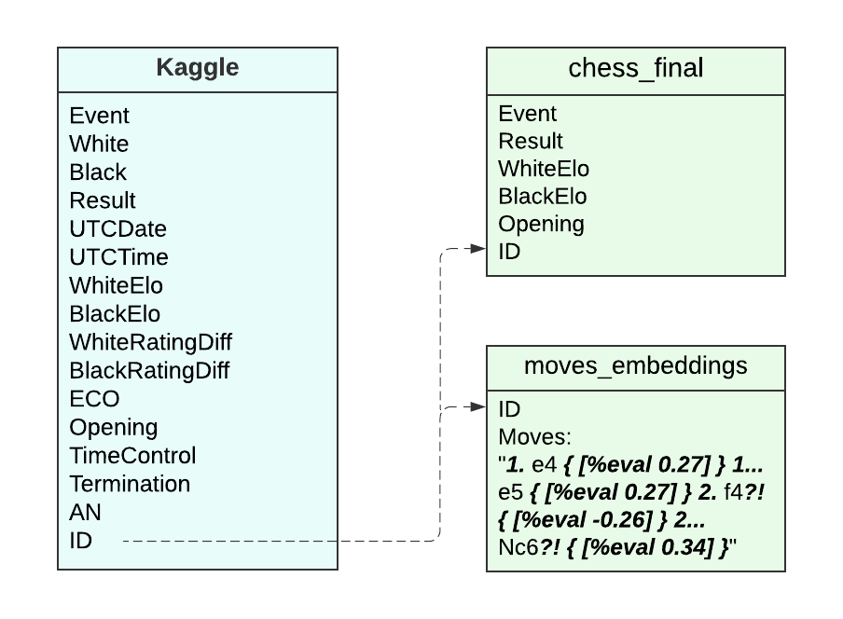
Datasets
Normalization
One-hot Encoding
Training predictor model
Embeddings
6,256,184 rows

Slide 10
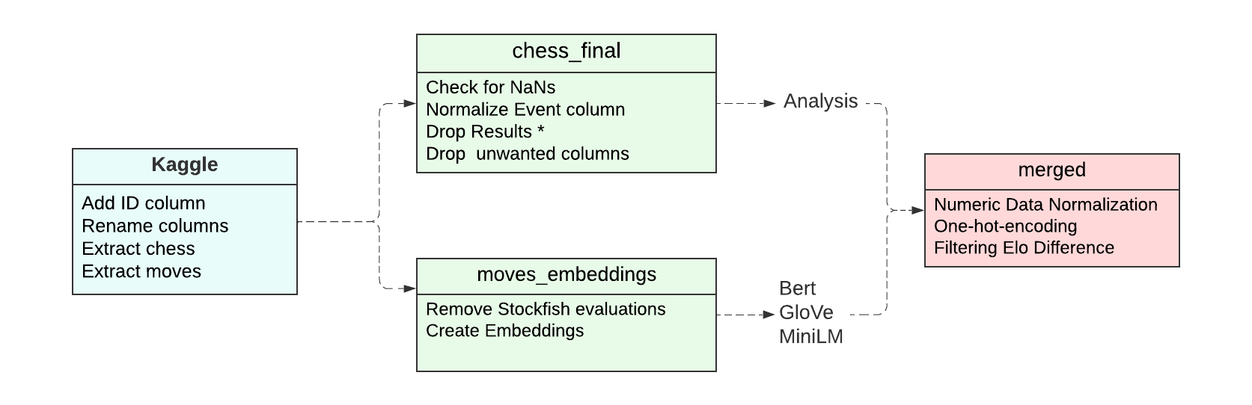
Data Transformations

Slide 11
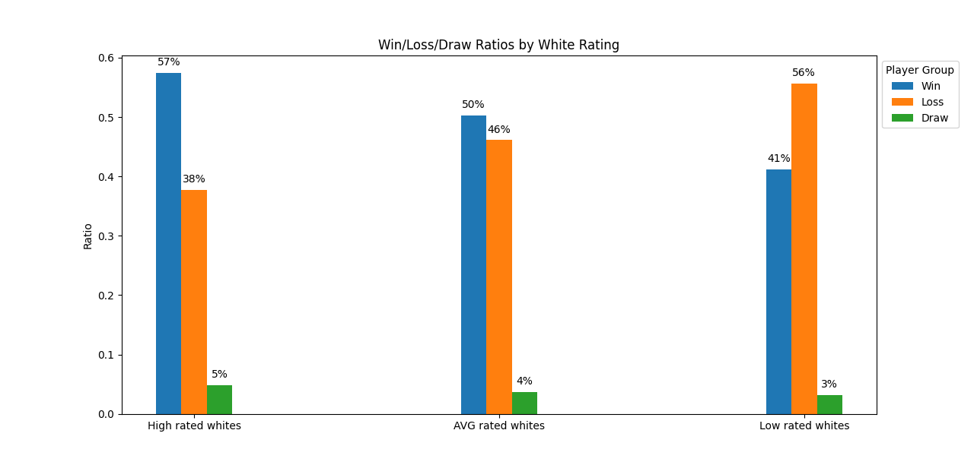
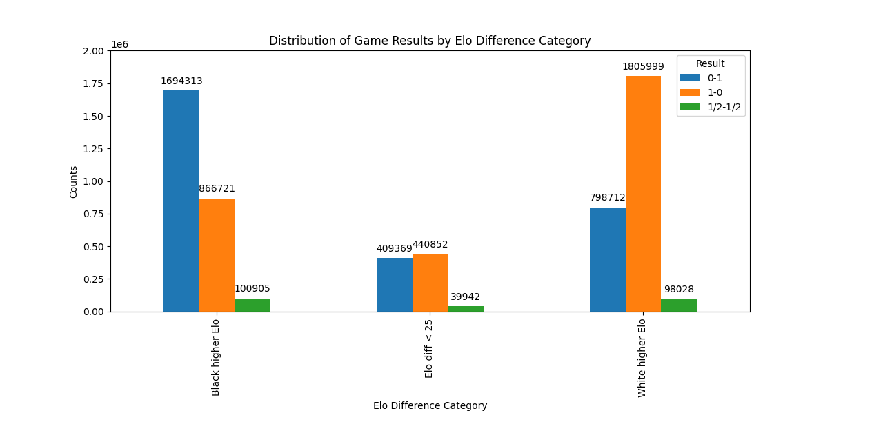
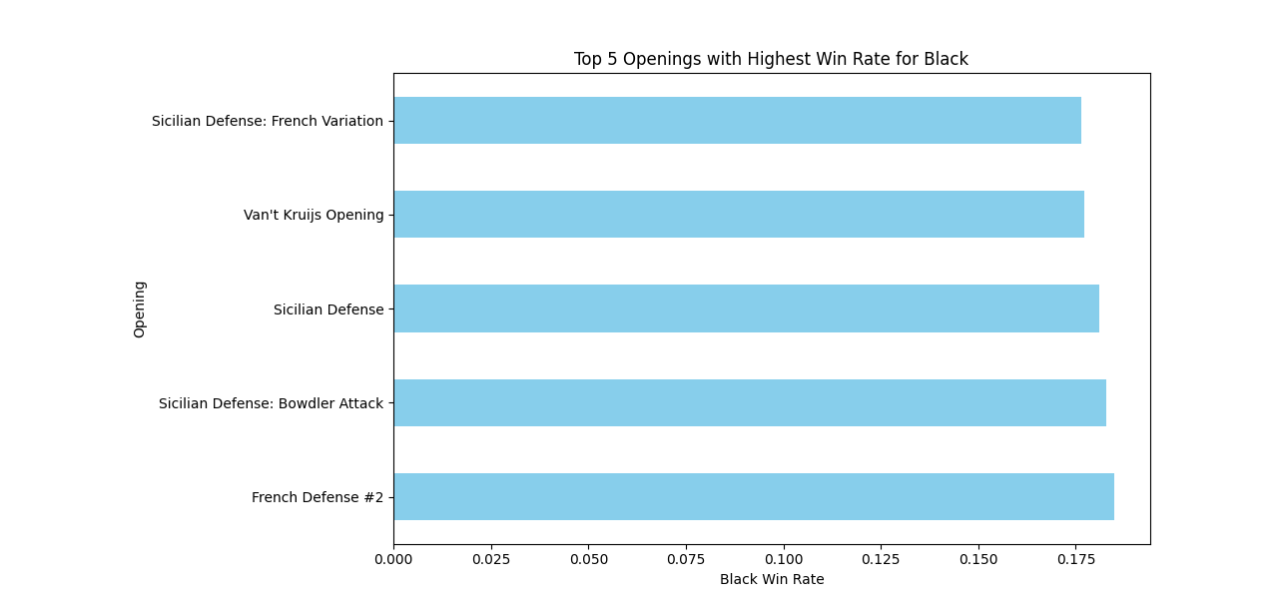
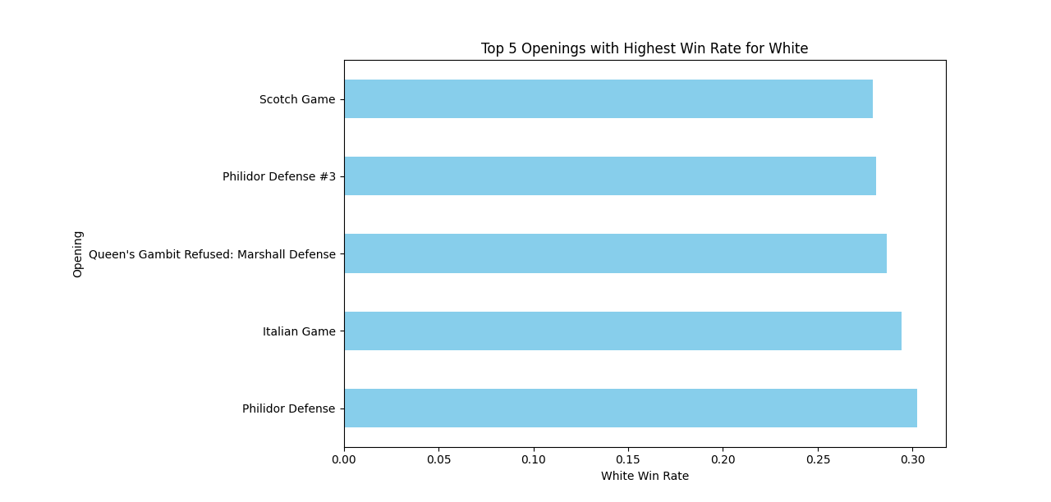
Data Exploration

Slide 12

Algorithms and methods
Bert
GloVe
MiniLM-L6-v2
Moves-Embeddings
API Requests
Training - Model

Slide 13
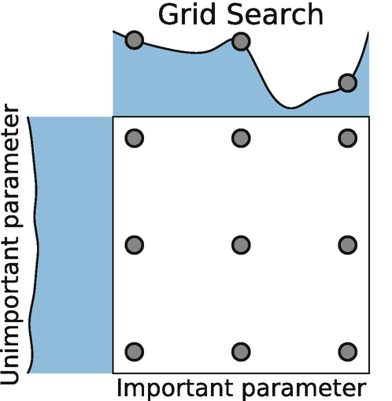

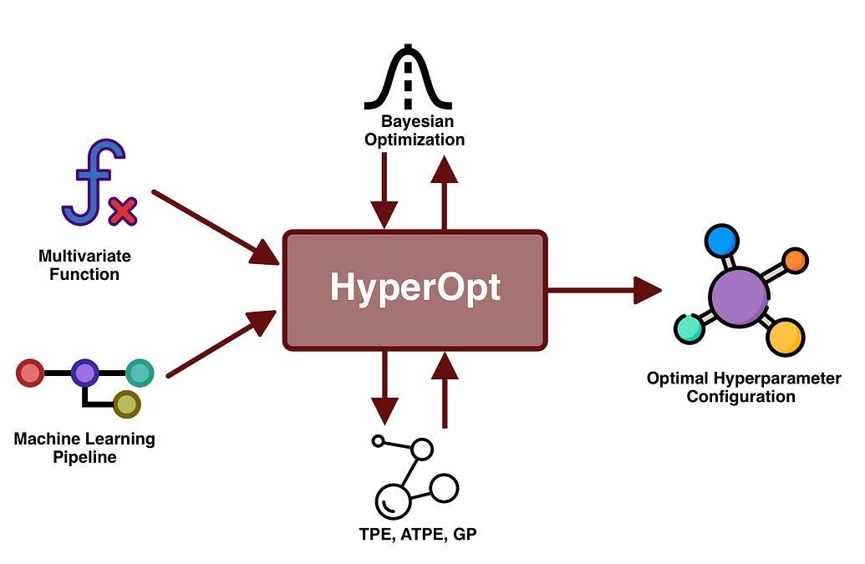
Splits, parameter tuning, cv…
80 % - Train
DataSet
WhiteElo BlackElo Type of Game (1-hot Encoding) Opening (1-hot encoding) Moves-Embeddings Result
HyperParameter Tuning
max_depth eta gamma reg_lambda min_child_weight scale_pos_weight
10 % - Val
10% - Test
HoldOut
491.000 rows

Slide 14

6. Results

Slide 15
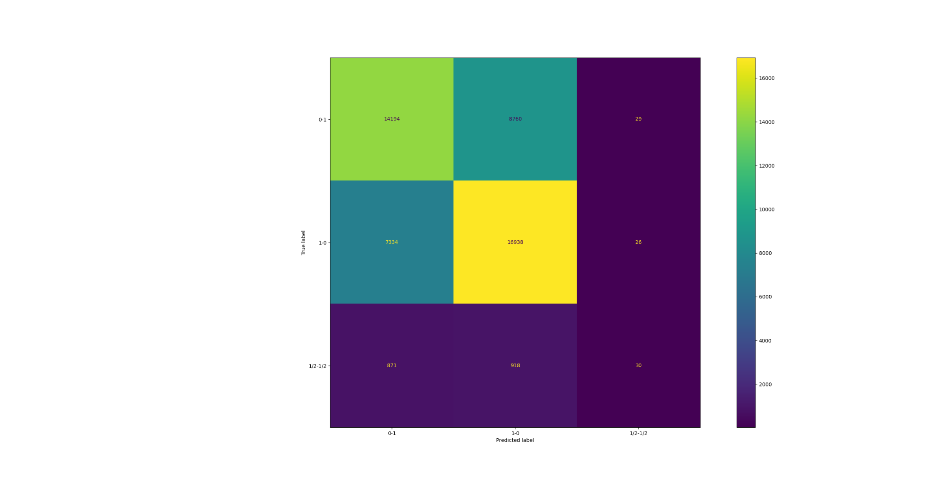
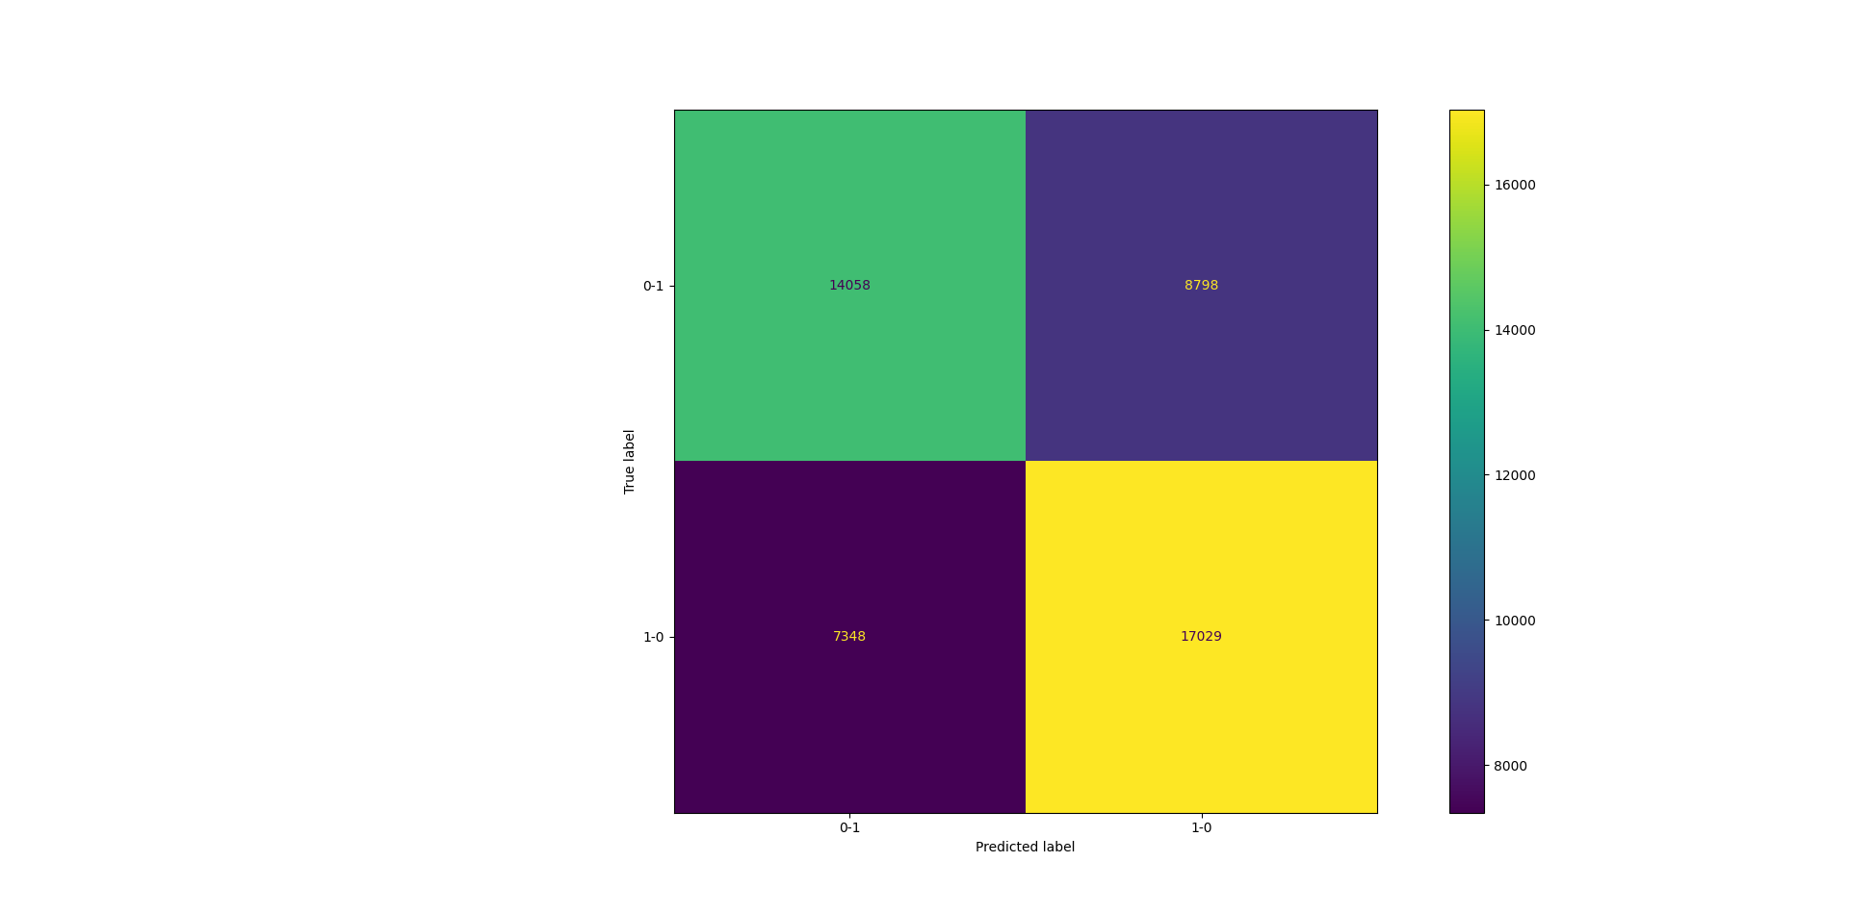
Results
Best Test-Metrics (Train Metrics) | Result Classification | Binary | Binary (Elo Diff ≤ 25) | Binary (No-Embeddings) | Binary (No-Embeddings) (ELO diff ≤ 25 )
Accuracy | 0.634 (0.65) | 0.658 (0.67) | 0.517 (0.53) | 0.654 (0.65) | 0.517 (0.52)
Precision | 0.624 (0.65) | 0.658 (0.67) | 0.511 (0.55) | 0.654 (0.65) | 0.534 (0.57)
Recall | 0.634 (0.65) | 0.65 (0.67) | 0.517 (0.53) | 0.654 (0.65) | 0.517 (0.52)
First Model Confusion - Matrix
Binary Model Confusion - Matrix

Slide 16
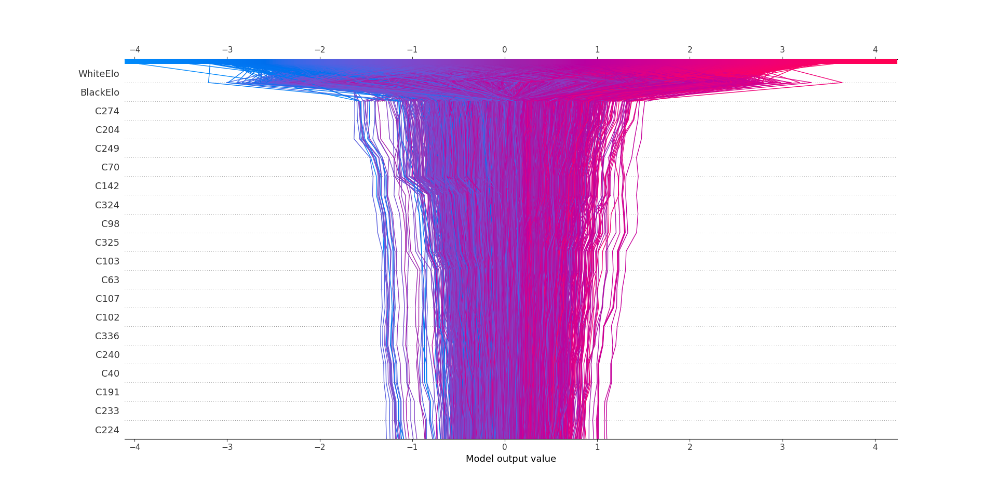
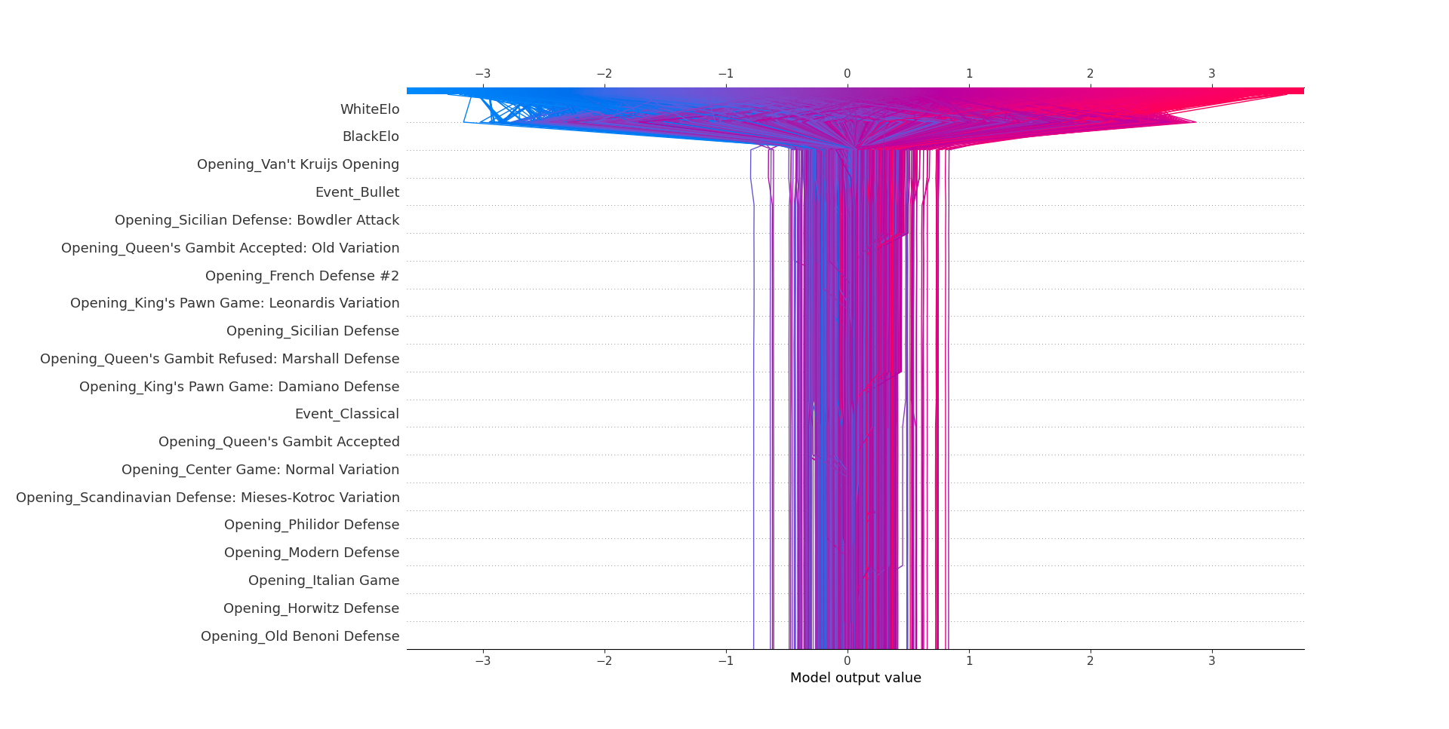
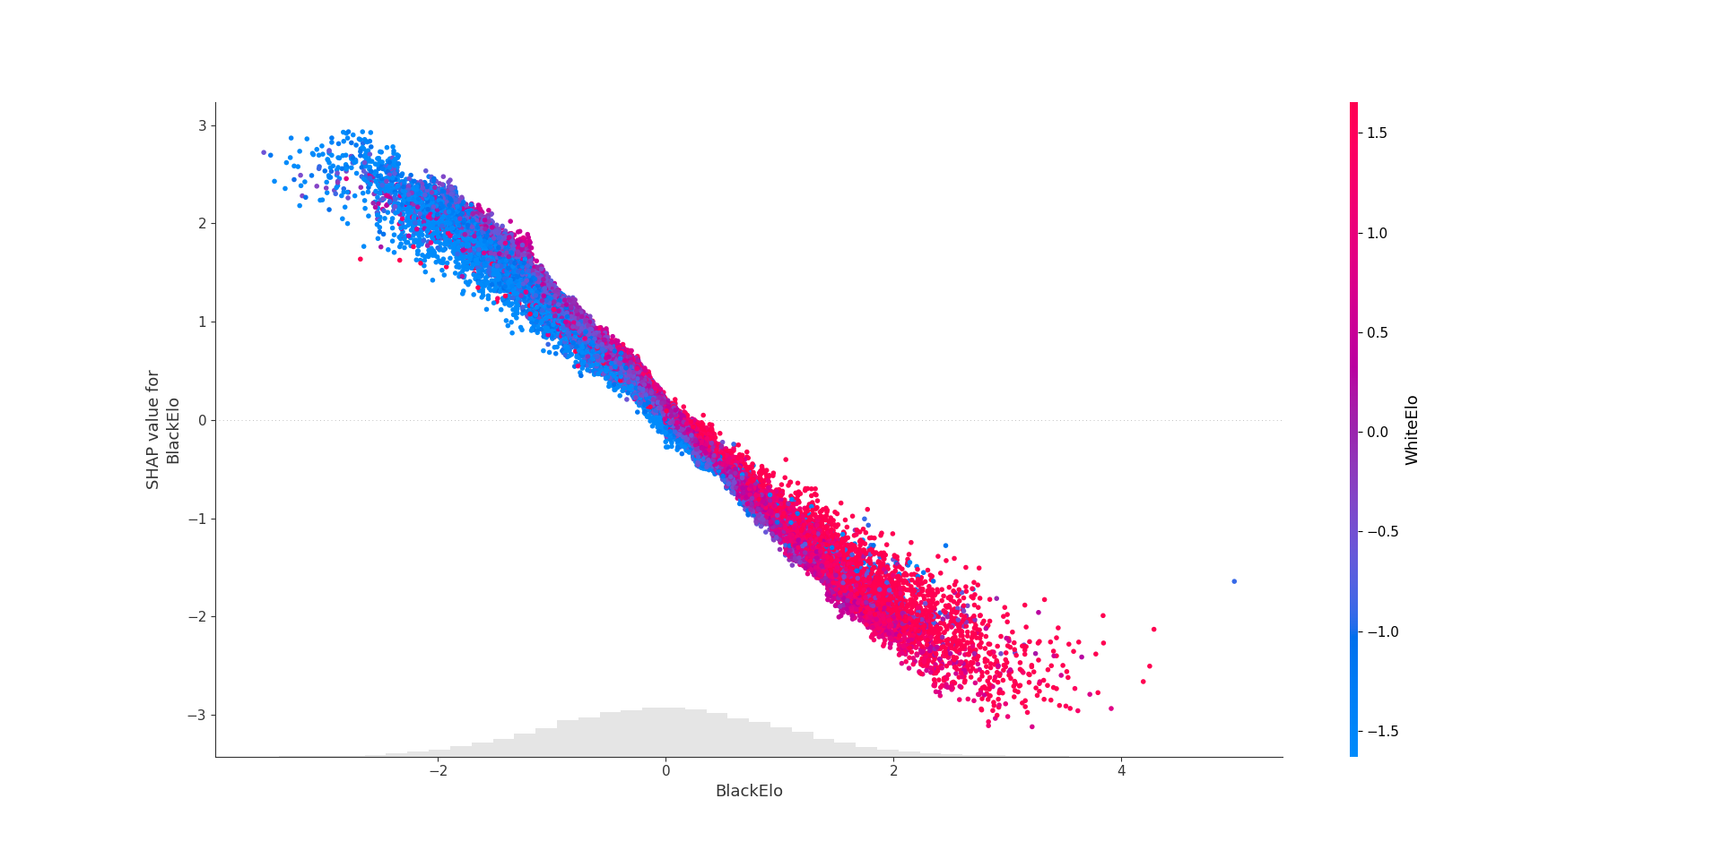
Insights From Results
Binary - Model - No Embeddings
Elo features are the most influential in the model decisions.
Lower ELO pushes opponent’s win prediction.
No difference of ELO -> Model outputs are random.
Embeddings provide almost no improvement in model prediction.
Binary - Model

Slide 17
7. Use of LLM
Icons and logotype
Organization
A
Debugging
Name

Slide 18
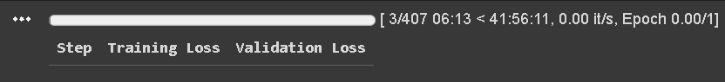


8. Conclusions
Grandmaster
Limitations
Limitations
High times of executions.
Lack of computational resources.
Possible Improvements
Different Approaches
Forecaster
BERT.
Fine-Tune.
More Embeddings.
New features.
Custom Embeddings.
Translate PGN moves into natural language. [1]

Slide 19
Thank you!
Any questions?
[1] Rabii et al. (2021, October). Revealing game dynamics via word embeddings of gameplay data

